Slide 1

Yelp Data Analysis
Vinay Kota,
Utkarshika Baidya,
Hemanth Doddala
MPS Data Science

Slide 2
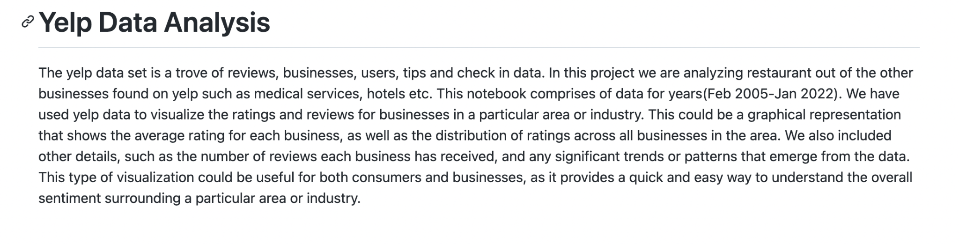

Slide 3
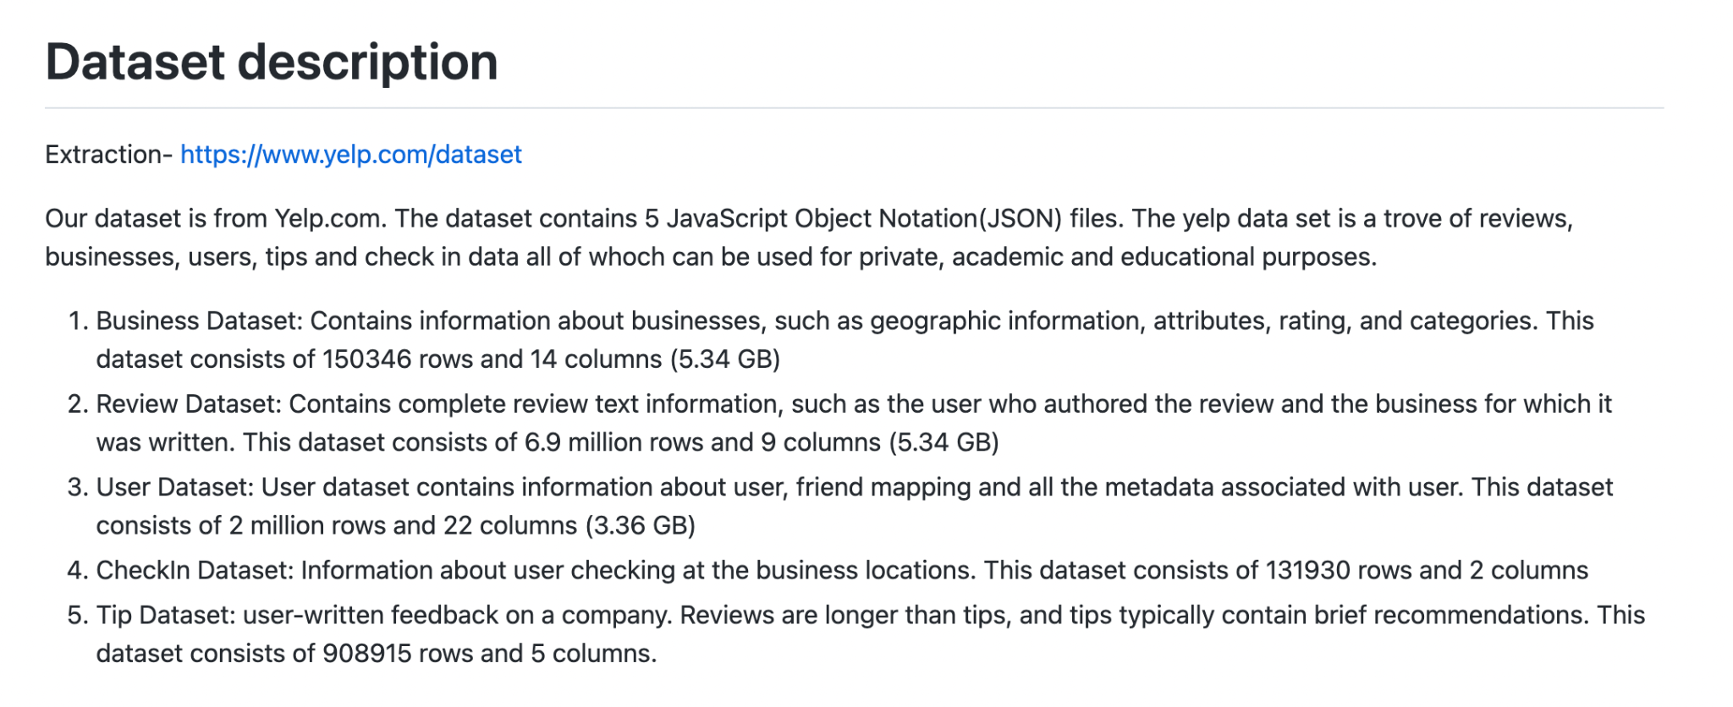

Slide 4
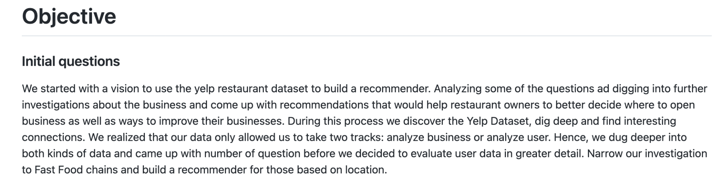

Slide 5
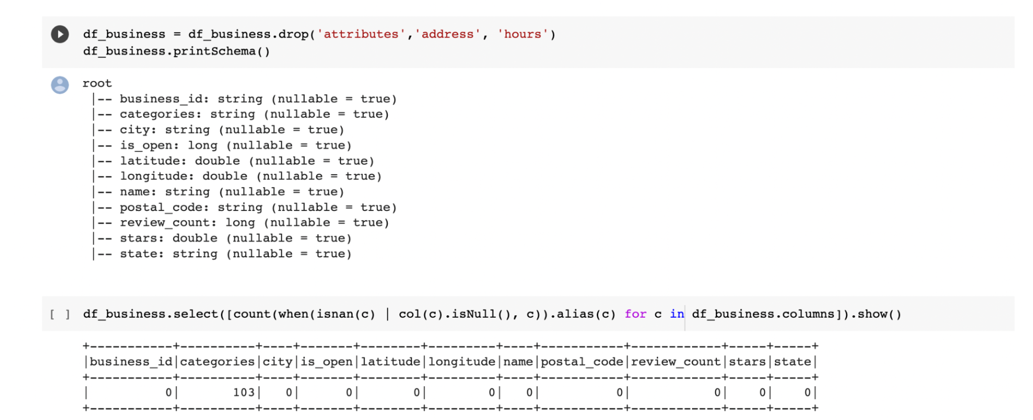
Step-1 Cleaning data (handling null values, dropping columns, changing data types)

Slide 6
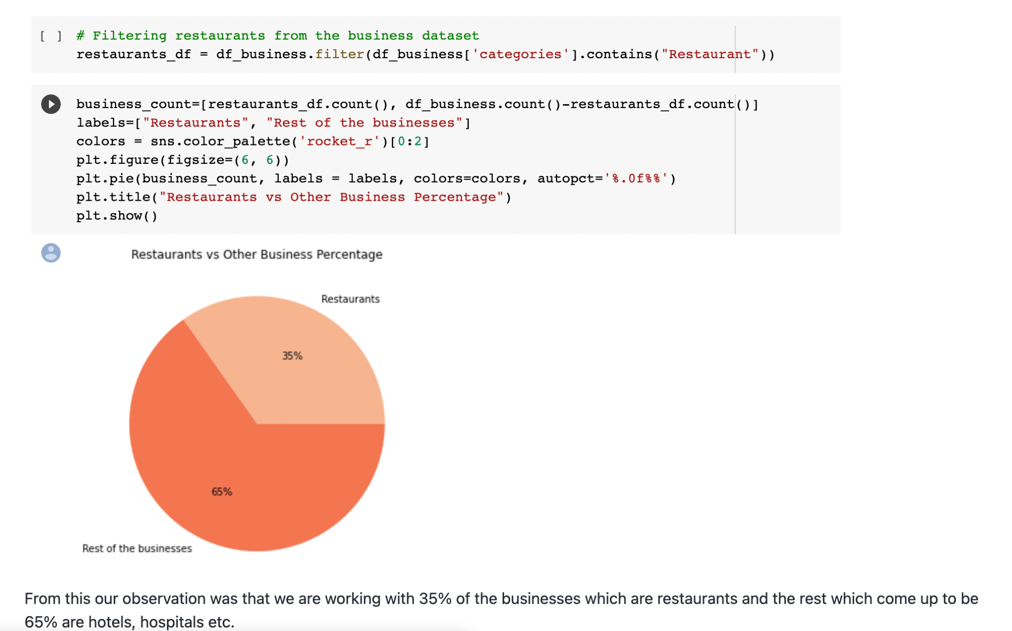

Slide 7
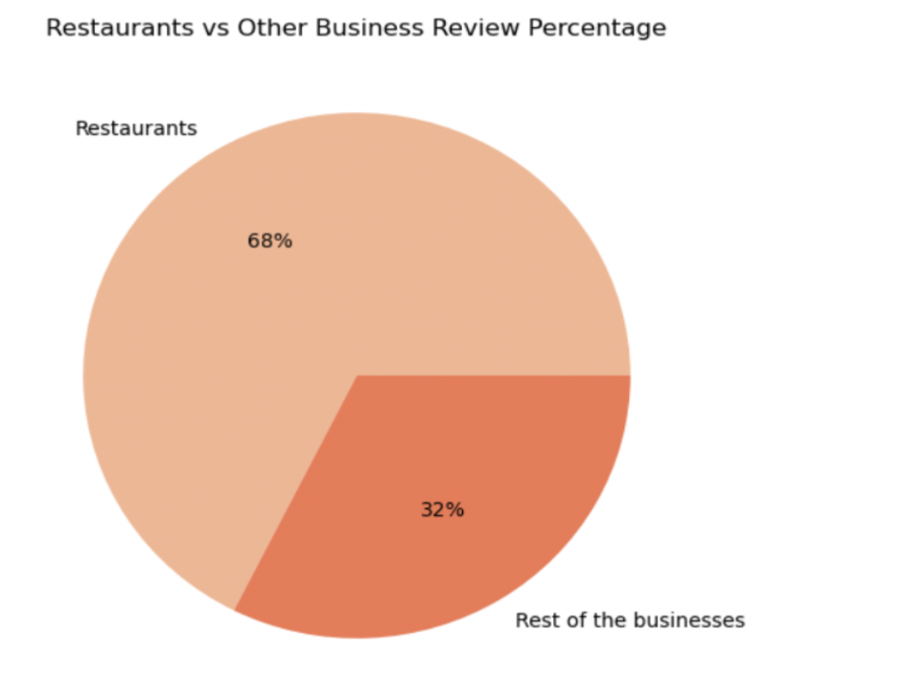
Step- 3 (Analysis)
After understanding the datasets and the components we wanted to analyse the combination of the datasets and bring out meaningful information from it. Hence, we started to join the datasets. We have layers to our analysis which are shown below.
Reviews distribution: Our first finding was that out of total about 68% of the reviews that are on Yelp comprise of reviews for the restaurants and only 32% for other businesses, i.e 2/3 of the reviews.

Slide 8
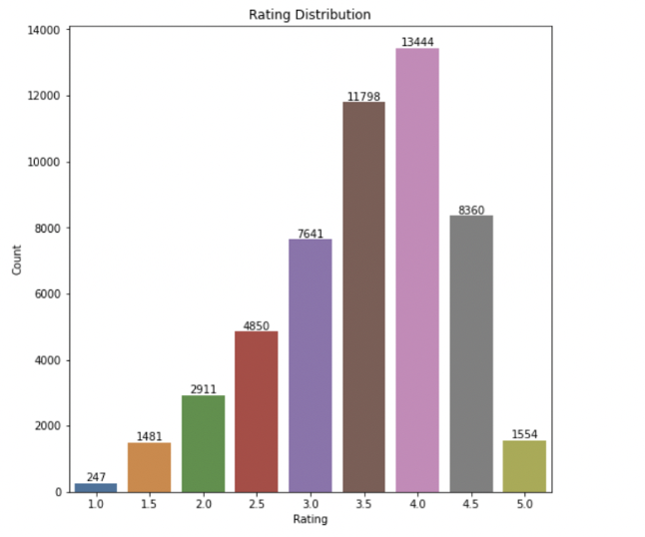
Findings
Rating distribution: From our analysis we were able to see the overall rating or the distribution of ratings across the restaurants, where high number of restaurants saw a rating between 3.5 to 4.5
Trend for checkin and review to the star ratings: Checkin_count and the review count for the restaurants which shows that becasue of the rating of the restaurants the checkins have been affected.

Slide 9
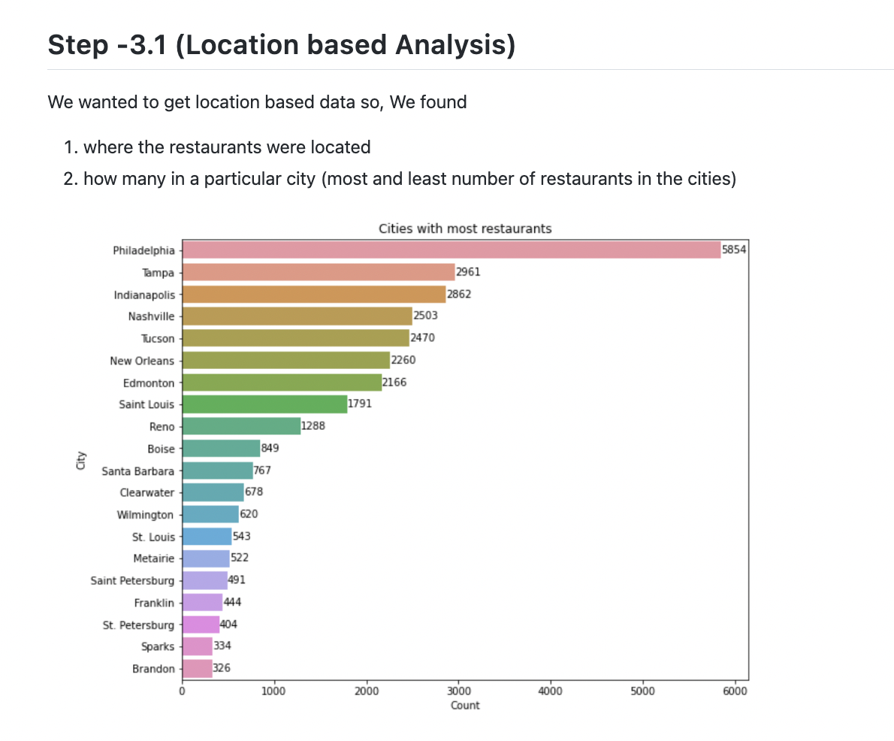

Slide 10
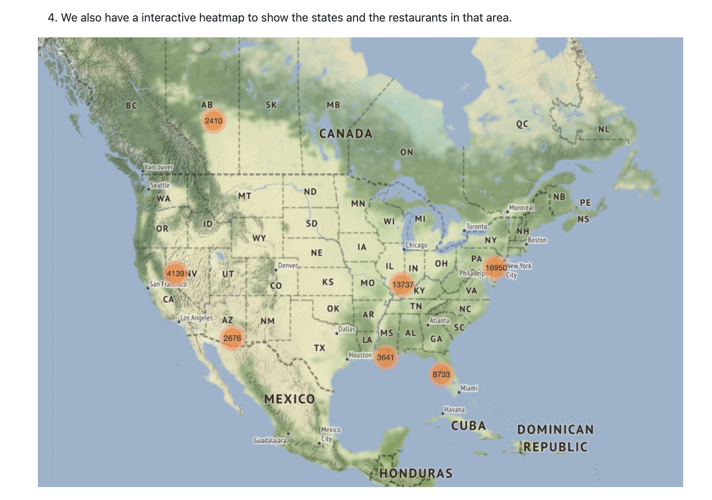

Slide 11
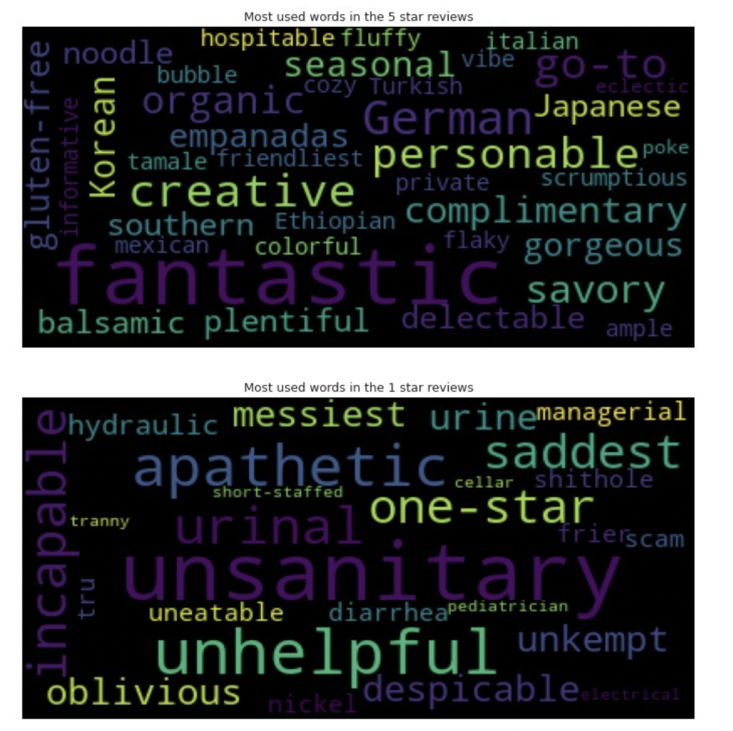
Review Words
For 5 star and 1 star Ratings
Findings : Cuisine Names, Adjectives, for food and ambiance
We wanted to analyse the pattern of words that are used in the top rated(5 star) and worst rated( 1 star) using WordCloud. We were able to fid out that both positive as well as negative meaning words are used in both the cases

Slide 12
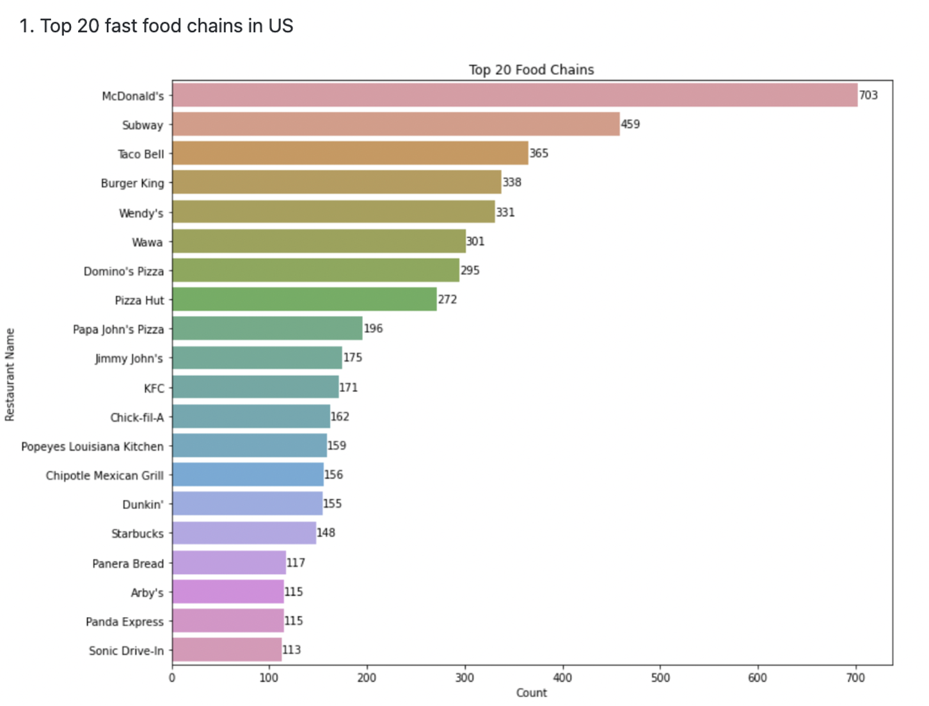
Fast Food Chains:
Here we see that McDonald's is the number 1 fast food joint followed by Subway, Taco bell and so on. We then just took the most popular burger joints namely McDonald's, Burger King, Wendy's and Chick-fil-A for further analysis.

Slide 13
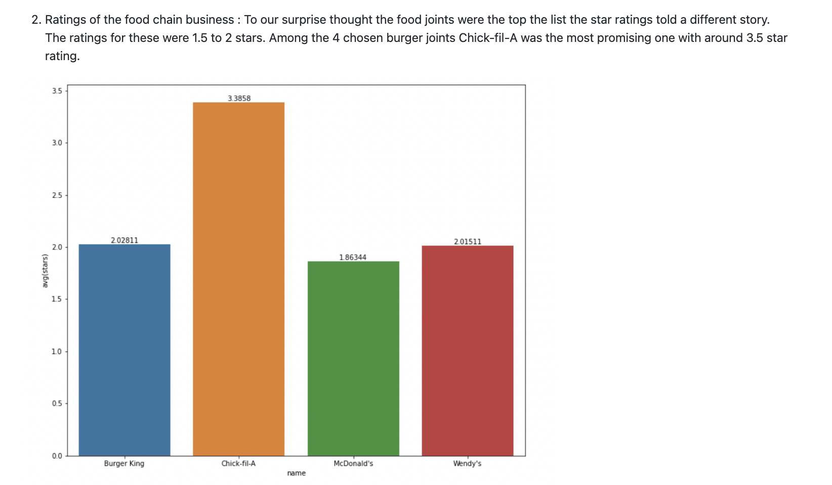

Slide 14
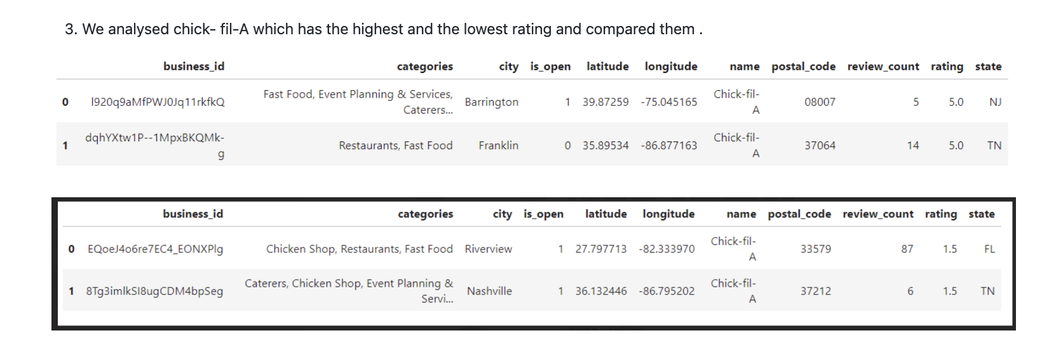

Slide 15
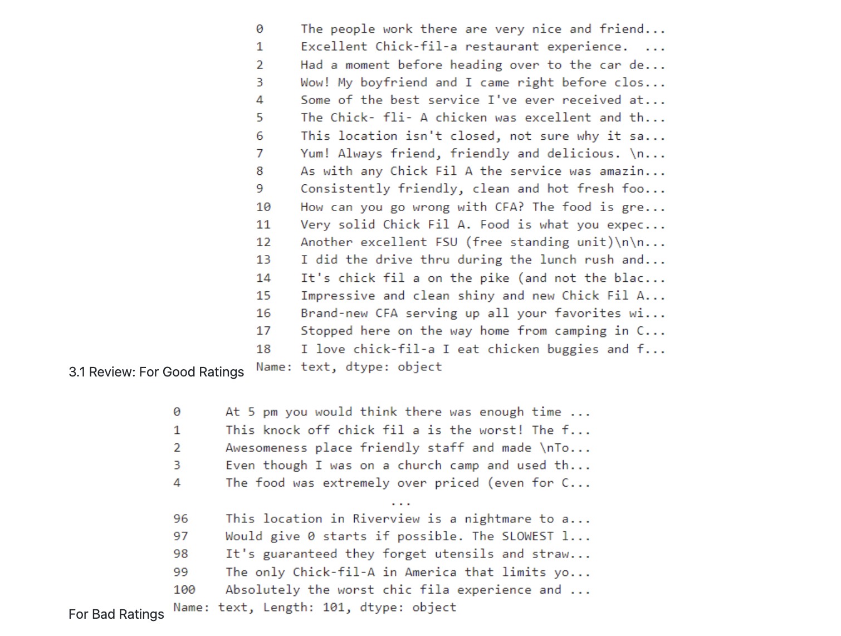
Reviews for chick- fil –A:
In the picture we can see reviews for chick-fil-A with 1 star and the 5 star rating in the same area.

Slide 16
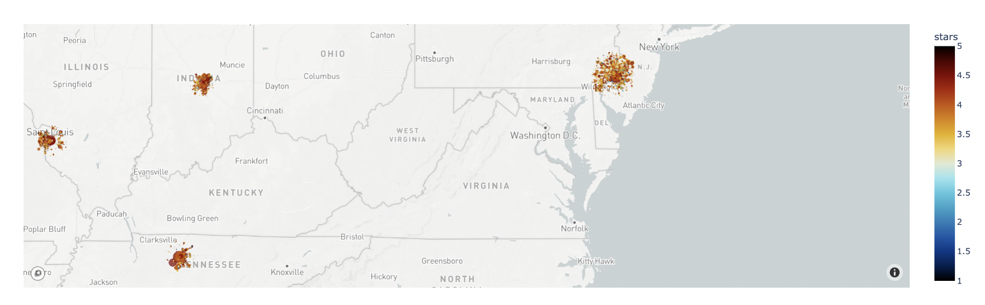
Step -5 (Recommendation system based on location)
Scatter plot that shows the Restaurants based on the ratings

Slide 17
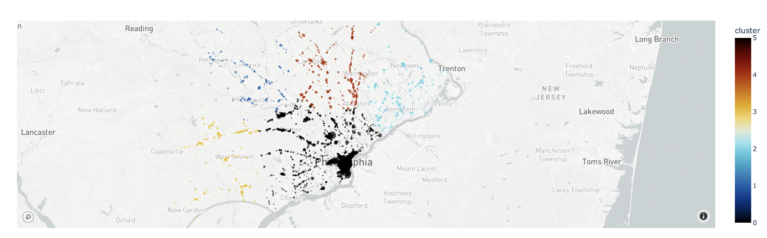
Since, Philadelphia consists of most number of high rated restaurants, the restaurant distribution has been divided into clusters using kmeans algorthm. Using silhouette score, the best number of clusters is chosen as 5. A function then helps in recommending the best restaurants given a certain co-ordinates.

Slide 18
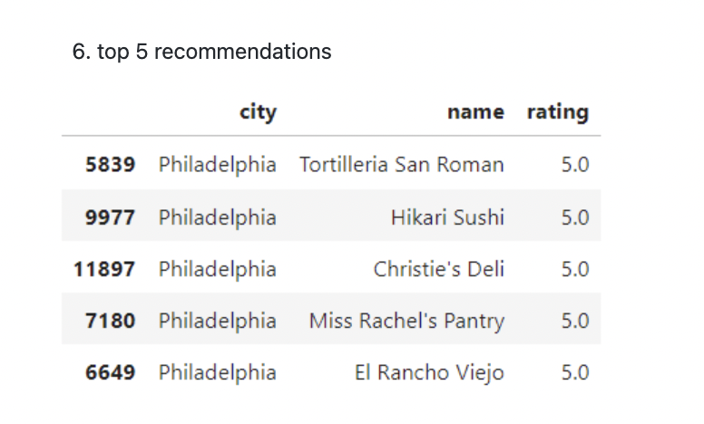
Top 5 recommendations based on latitude and longitude (users location)

Slide 19
Suggestions for the restaurant business based on the analysis finding
Service is the most important factor, if you want to have better ratings or customer attraction you must improve on the service.
Hygiene is another factor that determines the likeness for the customers.
Businesses should look at their reviews and try to improve based on that given reviews as they say a lot
Challenges
Reading data from Hadoop after inserting data into HDFS.
While cleaning data for business- the same restaurant has multiple spellings listed(unique entries but is the same restaurant.
Not able to Use MLlib for clustering.

Slide 20
Conclusion
1. Among all the business that are found on yelp Restaurant business comprises of 35% of the total.
2. About 2/3rd of the reviews that can be found on yelp are comming from restaurants i.e 68%
3. Tips which are short reviews make up 71% from the restaurant business on yelp, which started from 2009
4. Majority of restaurants fall under 3.5 to 4.5 star ratings.
5. Star ratings have an impact on the checkins from customers.
6. Philadelphia, Tampa and indianapolis are the top 3 cities with highest number of restaurants
7. There are cities which have just 1 restaurant listed on yelp
8. Review count of Philadelphia is directly proportionate to it reviews and has the highest reviews for the restaurants.
9. To our surprise the top fast food/ burger joints have the worst rating. out of which Chick - fil- A is the best as of the average rating with 3.3.
10. Chick- fil- A though was the best among the others they also had ratings that were 1.5 and 5 in certain areas. Since we found 1.5 and 5 both are in the same area , location really doesnt play a significant role but it is the service that determines whether the business is good or bad.
11. We were able to come up with a model that gave us a location based recommendation where user gives the latitude and longitude.
Note: The orange bold bullets are key findings out of the many

Slide 21
Thank You

